Slide 1
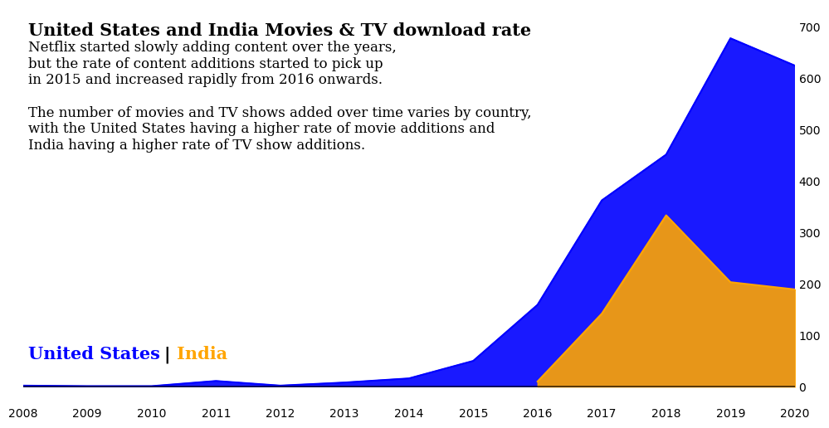
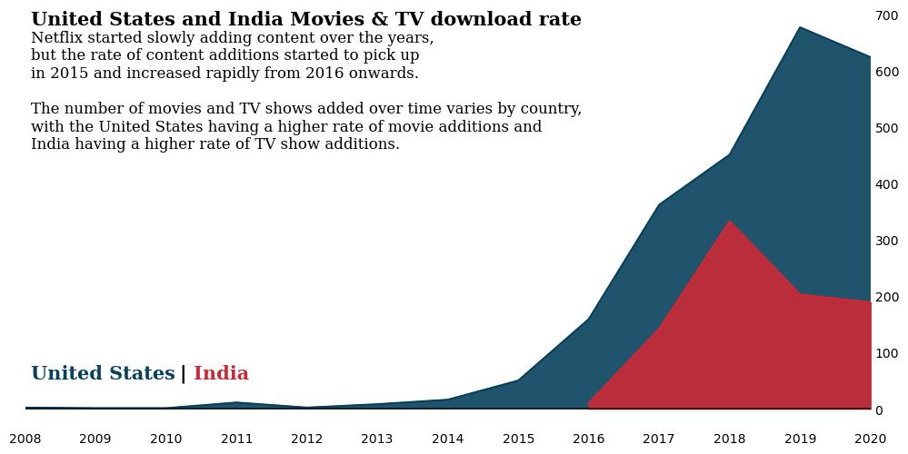
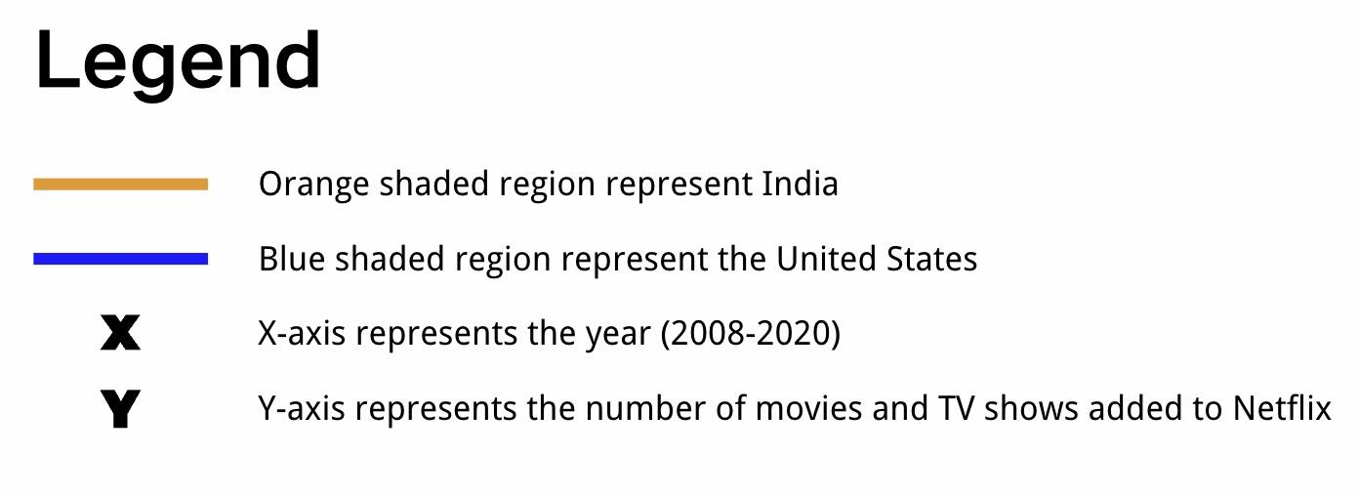
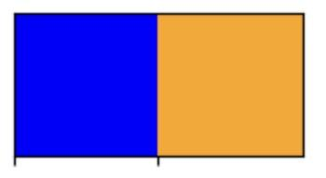
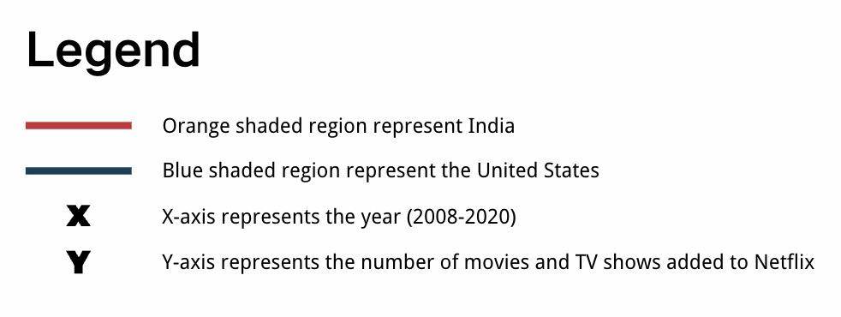

Netflix Data Analysis
Midterm Report: Comparison of Movies and TV Shows Download Rate between United States and India on Netflix

Slide 2
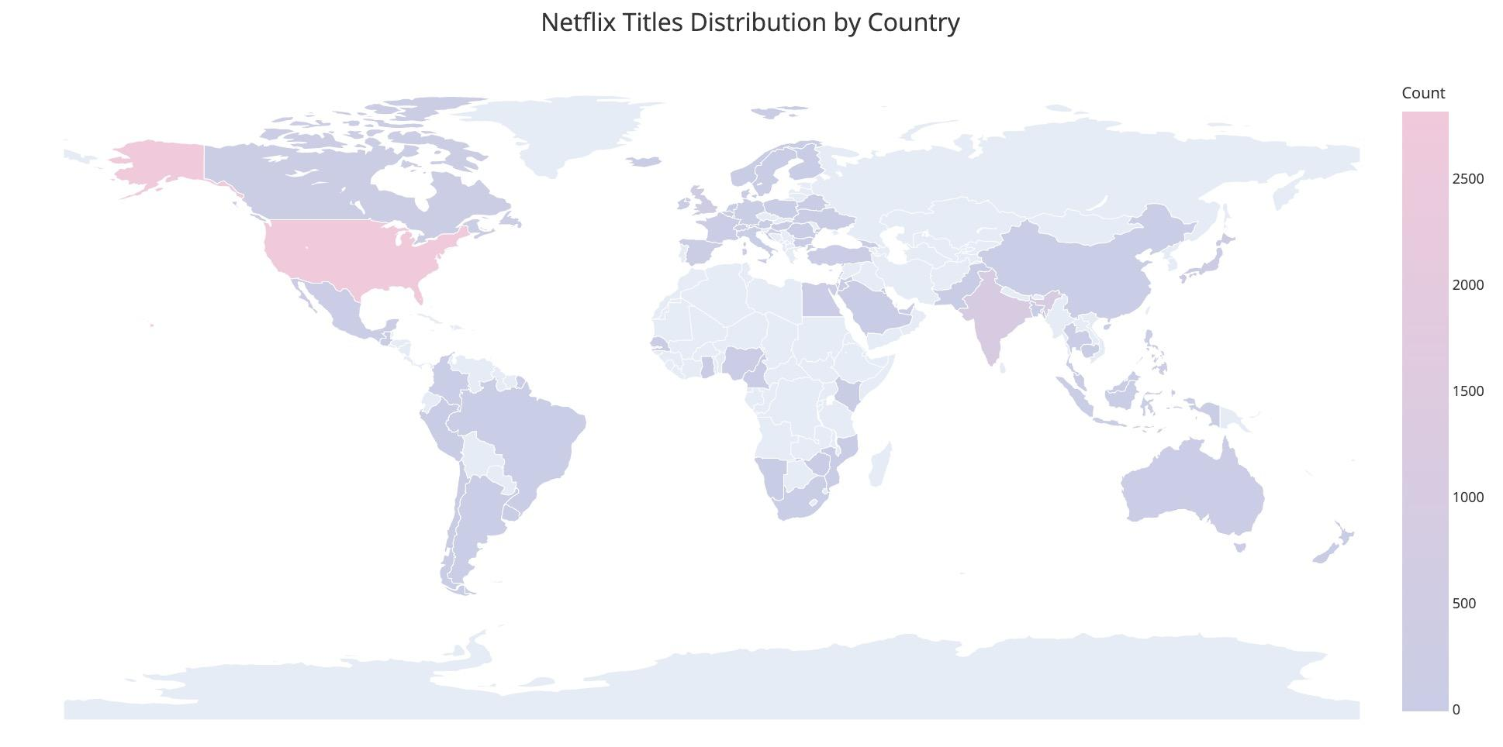

Netflix Data Analysis
Final Report: Netflix Titles Distribution by Country
Legend：
The map shows the distribution of Netflix titles by country, with pink colors representing countries with more titles and blue colors representing countries with less or no titles
Hovering over a country displays the name of the country and the number of Netflix titles in that country.
The color bar on the right side of the map shows the range of values for the number of Netflix titles in each country, with darker colors representing higher values.

